Slide 1

Computational Biology techniques I
Theoretical and experimental spectrum alignment

Slide 2

Team members
Elshaymaa Ahmed Hassan
Hasnaa Mohamed Kamel
Asmaa Hamed Farghali
Aya Ahmed Mohamed
Youstina Raafat Sobhi
Alaa Atef Mubarak

Slide 3

Spectrum alignment
There are several ways to find matching peaks between two spectra.
The most basic one is the Spectrum Alignment. It returns a list of matching peaks.
Here, in our project we take an observed (Experimental) spectrum and align a theoretical spectrum to it.
First we get the Experimental spectrum from the PRIDE Database.
And download the related fasta file sequence.

Slide 4
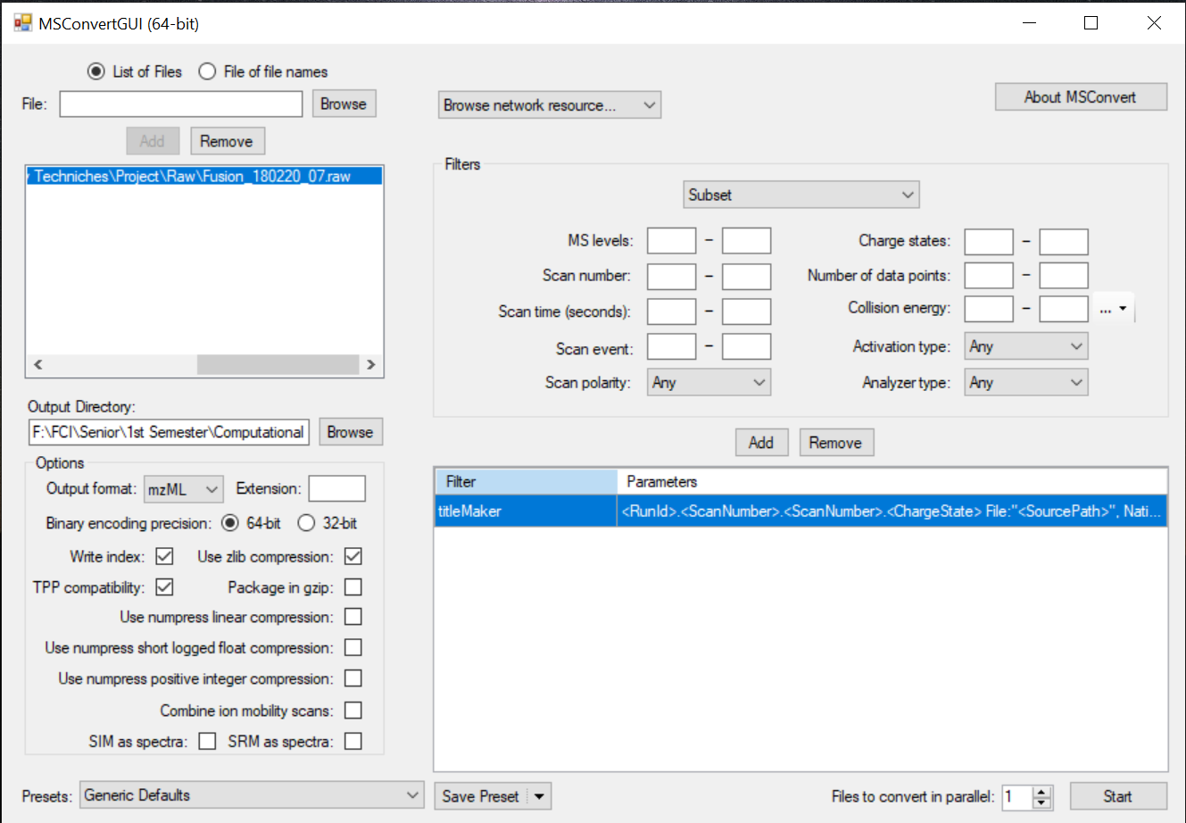
Proteo Wizard
After downloading the Experimental raw file
We will use the proteo wizard MSConvert program to convert the raw file to MzML extension file.

Slide 5
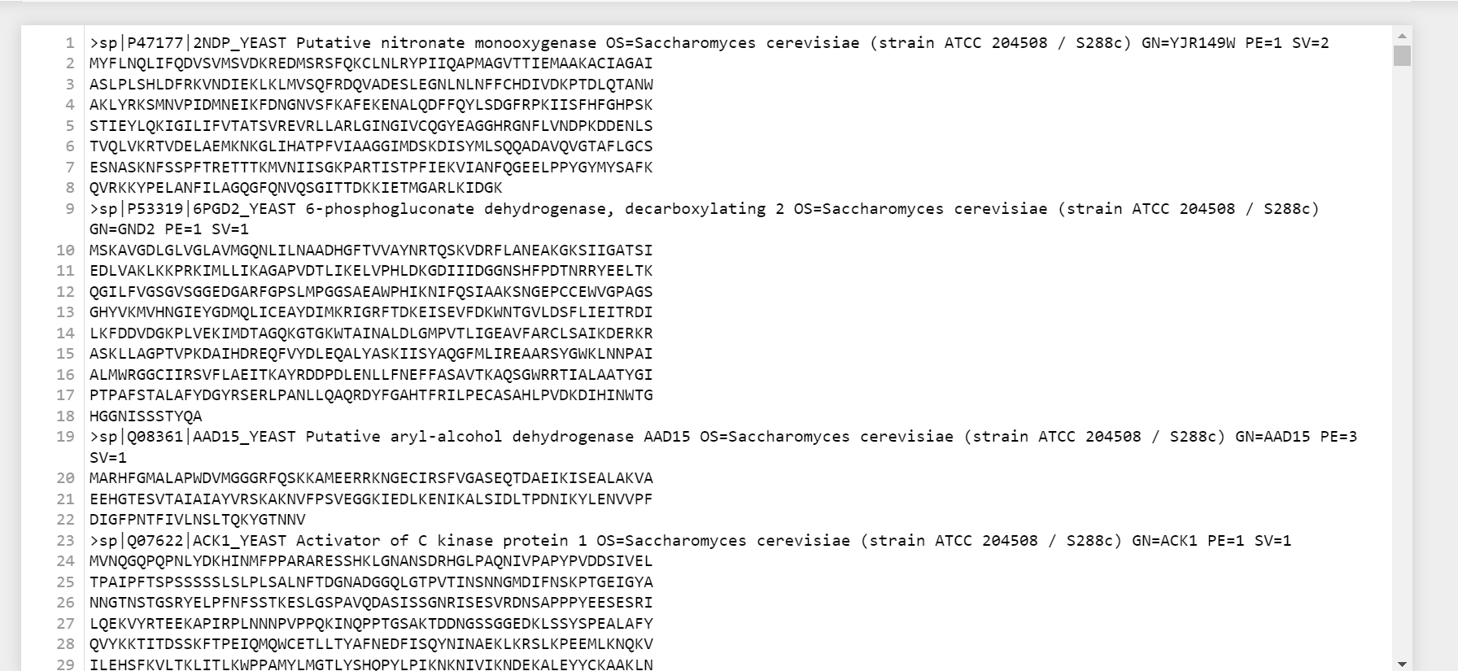
The fasta file
Here is the yeast fasta file contains the yeast protein sequence that we used
In the spectrum alignment

Slide 6
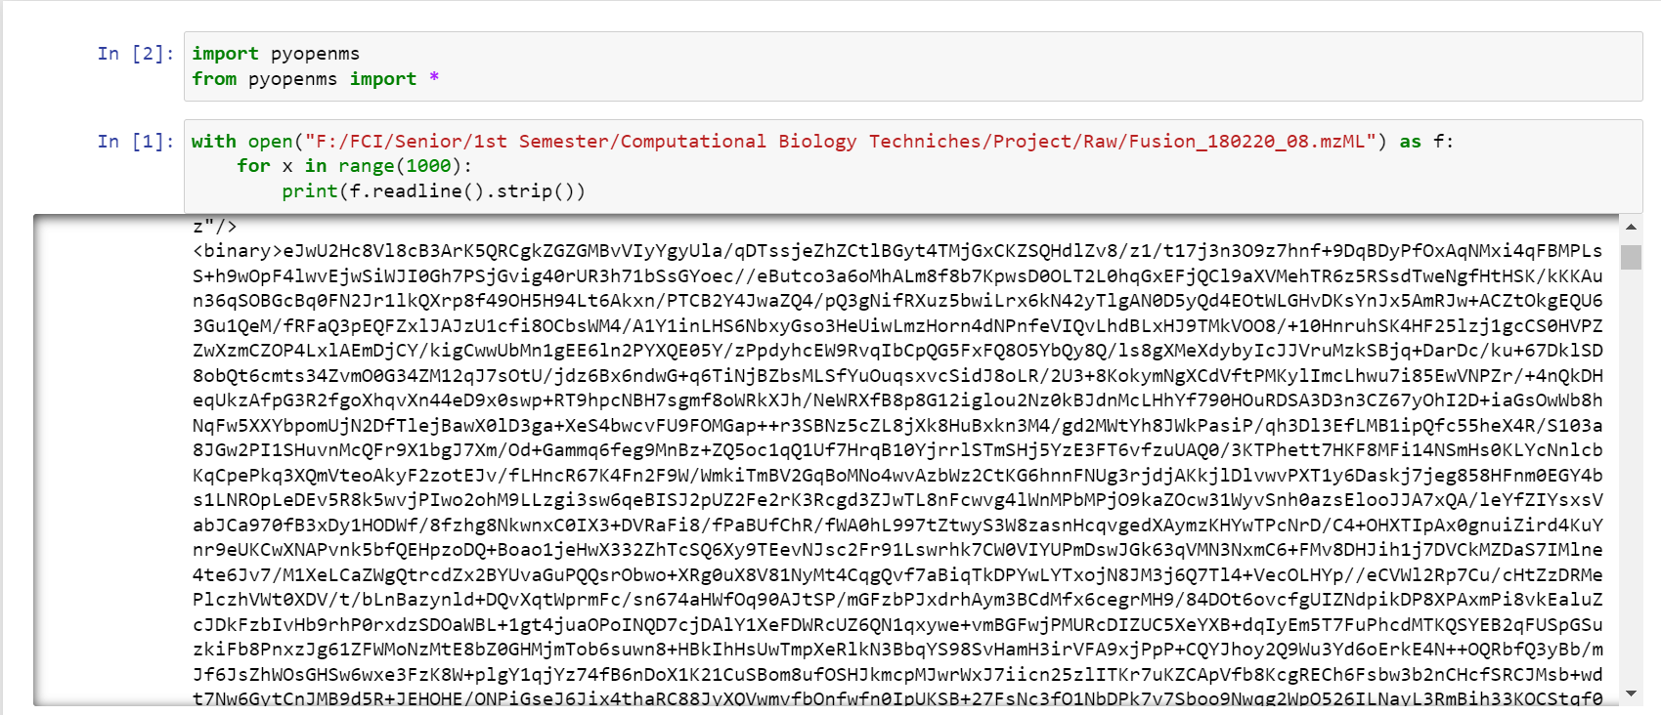
Read mzml file

Slide 7
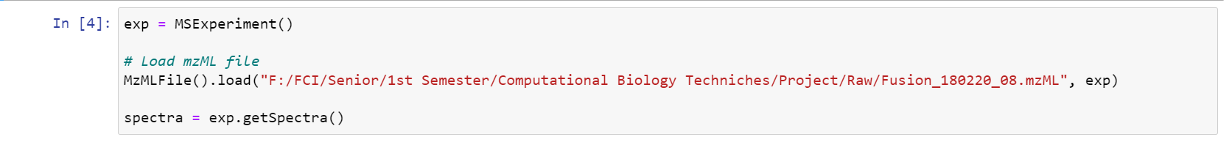
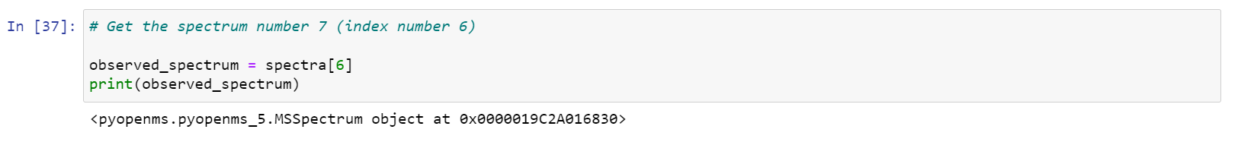
Load mzML file and obtain spectrum
Get The Spectra

Slide 8
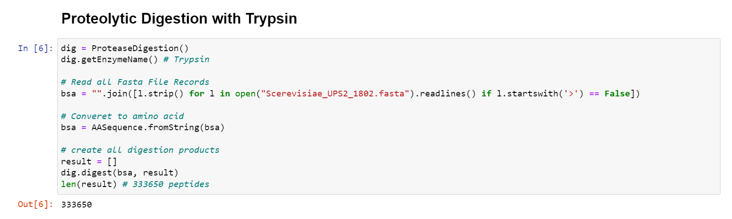
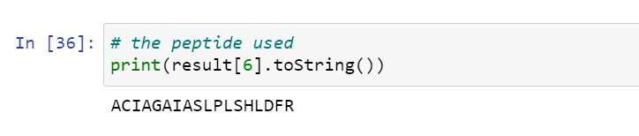
Digestion
The peptide of interest

Slide 9
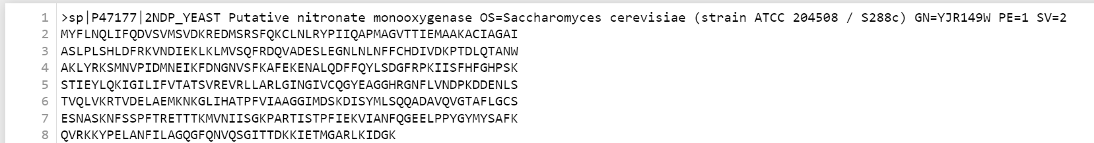
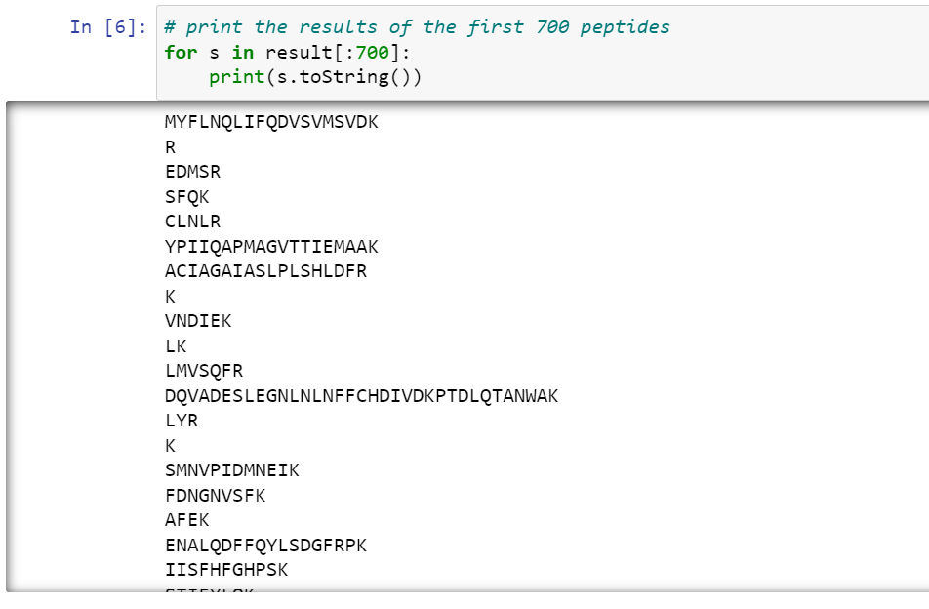
The protein of interest
Show peptides

Slide 10
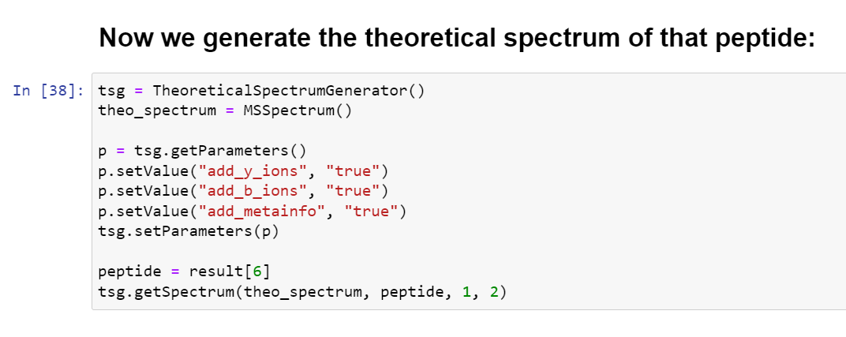
Generate the theoretical spectrum

Slide 11
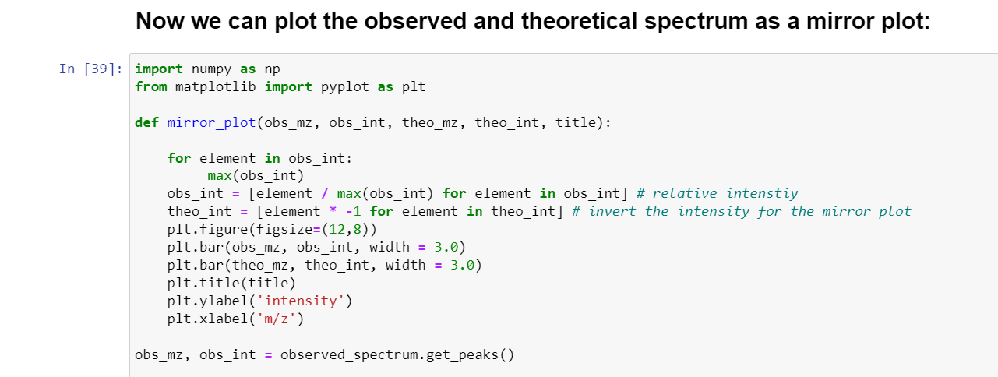
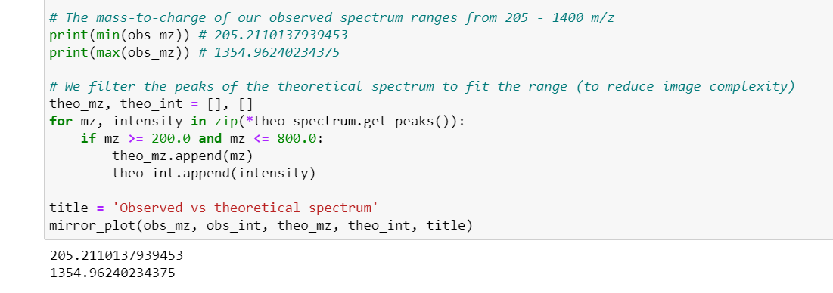
plot the observed and theoretical spectrum as a mirror plot

Slide 12
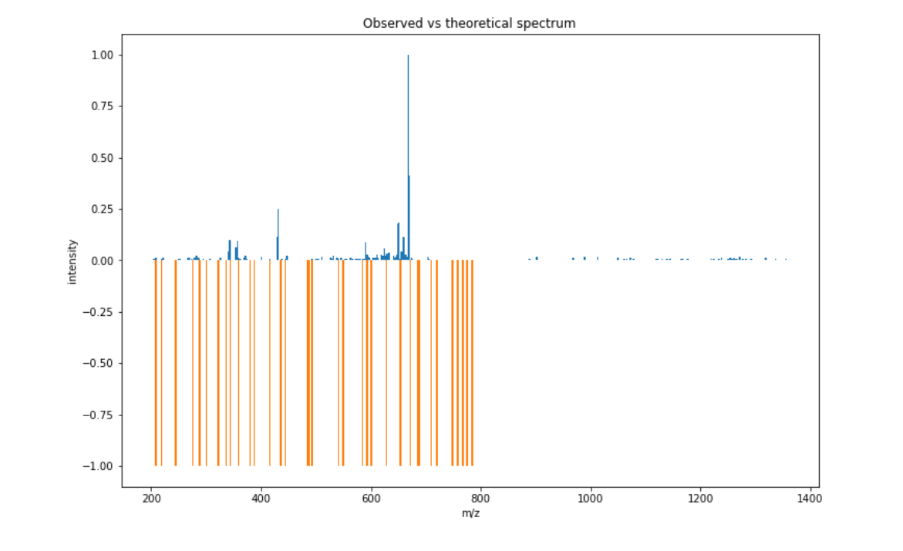
The Result

Slide 13
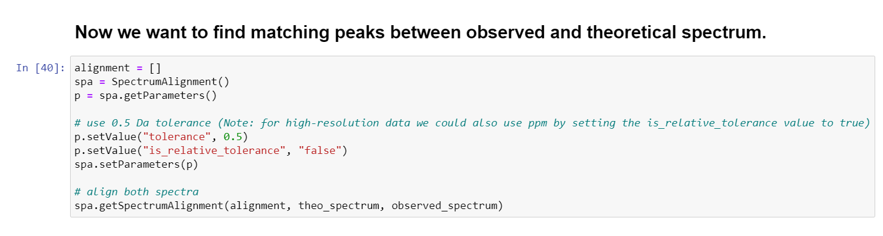
Align the theoretical and experimental spectra

Slide 14
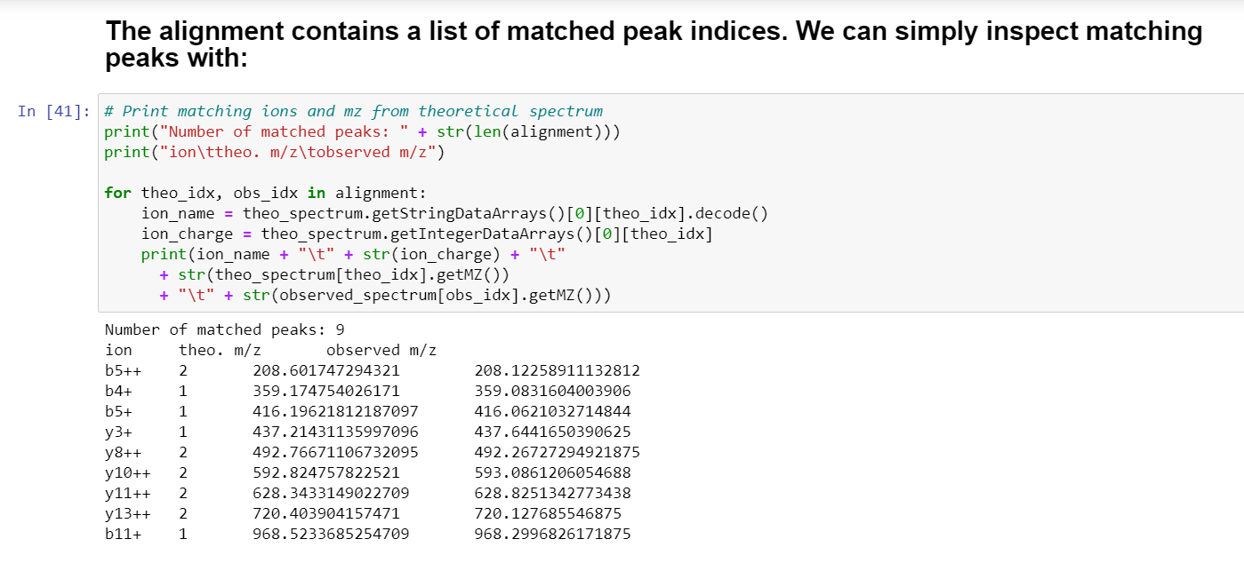
Find matching peaks

Slide 15
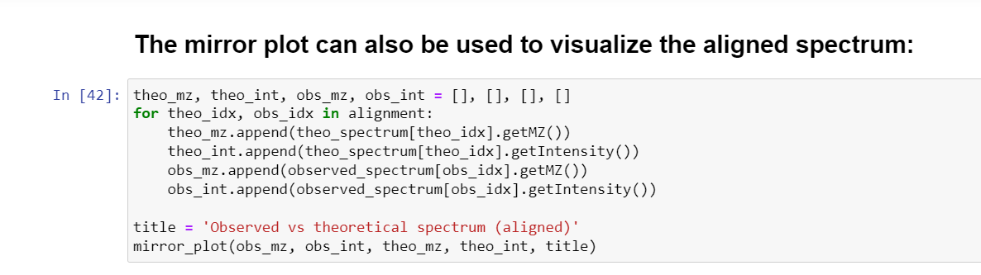
Aligned Spectrum Mirror plot

Slide 16
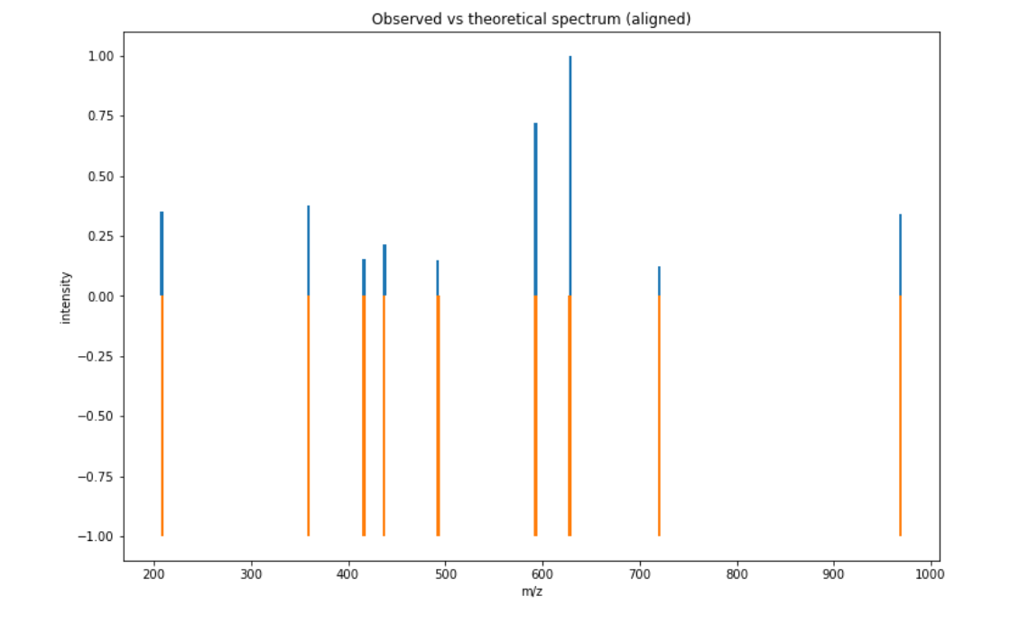
The Aligned Spectrum Mirror plot Result

Slide 17
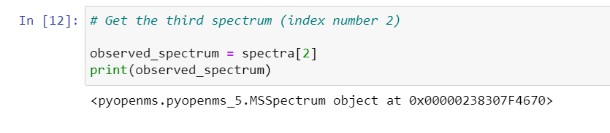
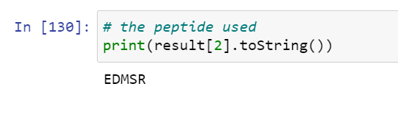
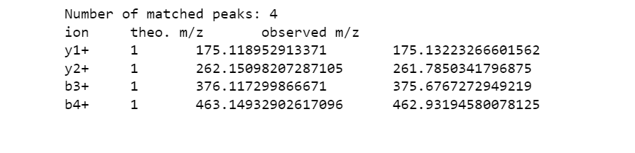
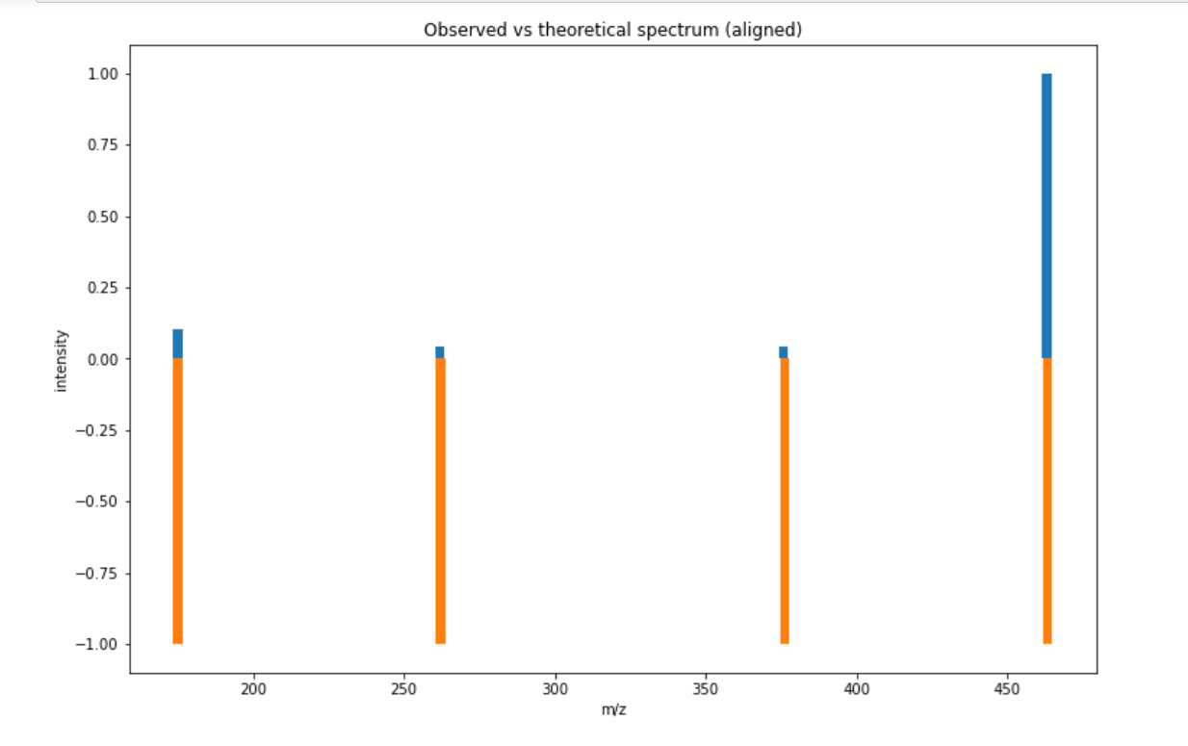
Spectra
peptide
Matched peaks
mirror plot

Slide 18
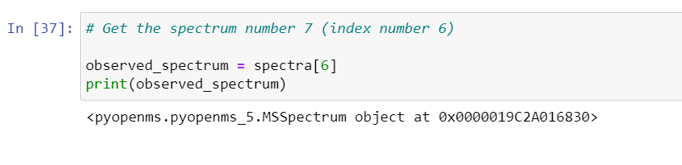
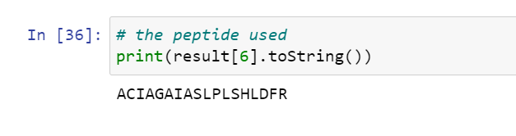
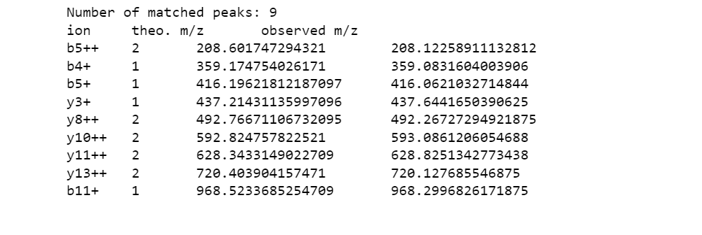
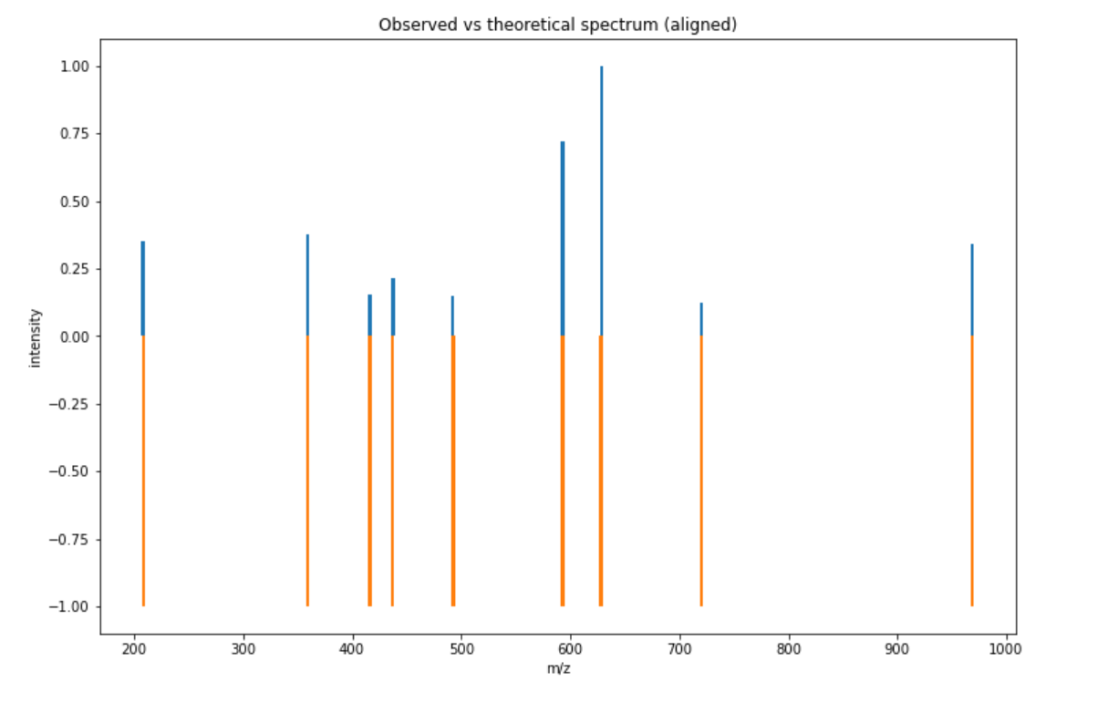
Spectra
peptide
Matched peaks
mirror plot
Fusion_180220_07.raw

Slide 19
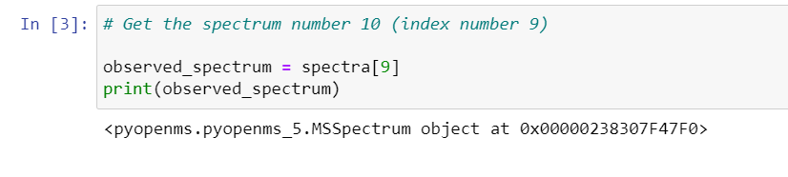
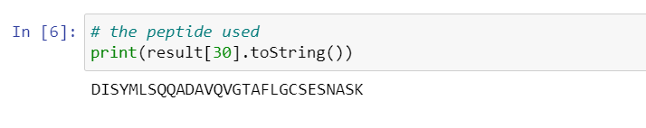
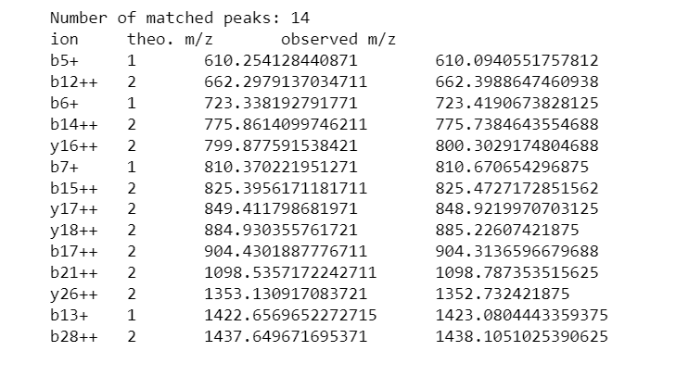
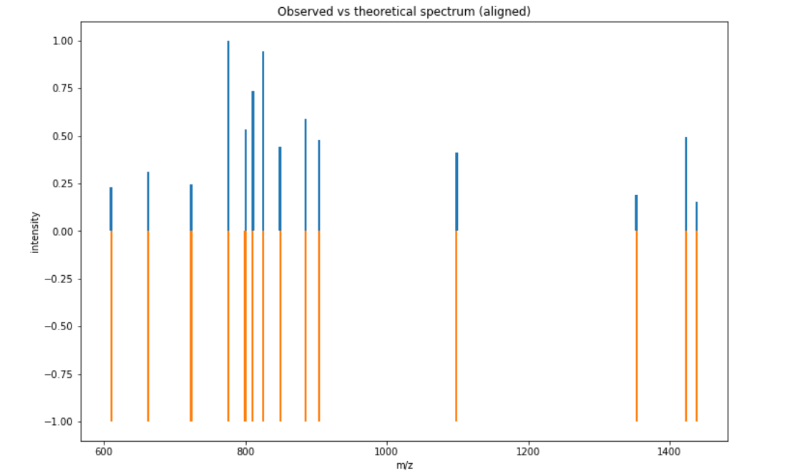
Spectra
peptide
Matched peaks
mirror plot
Fusion_180220_08.raw

Slide 20
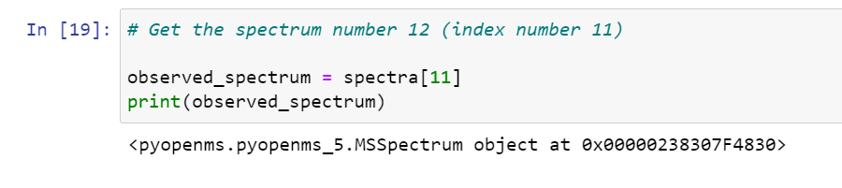
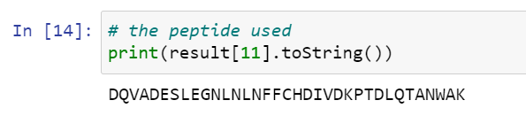
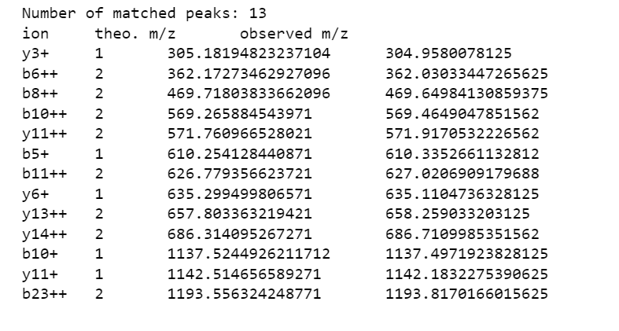
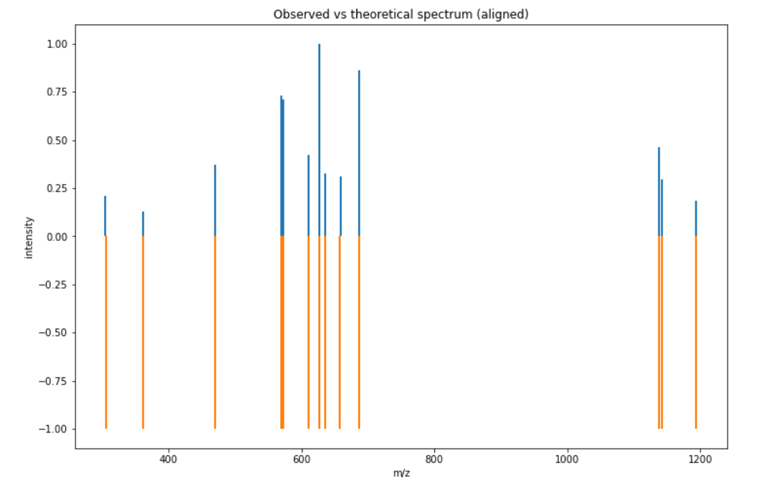
Spectra
peptide
Matched peaks
mirror plot

Slide 21
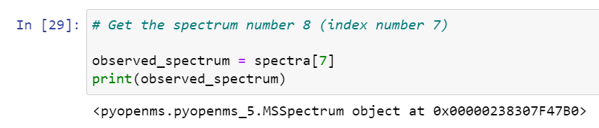
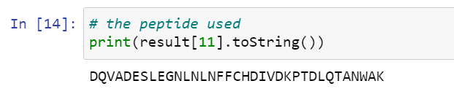
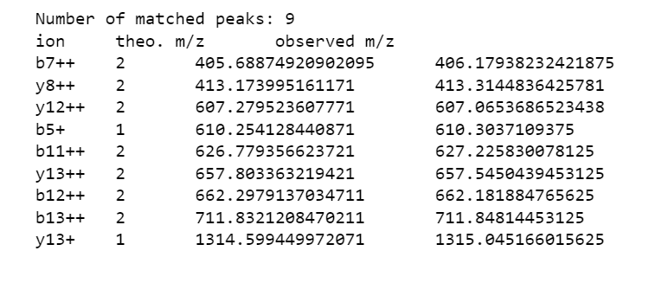
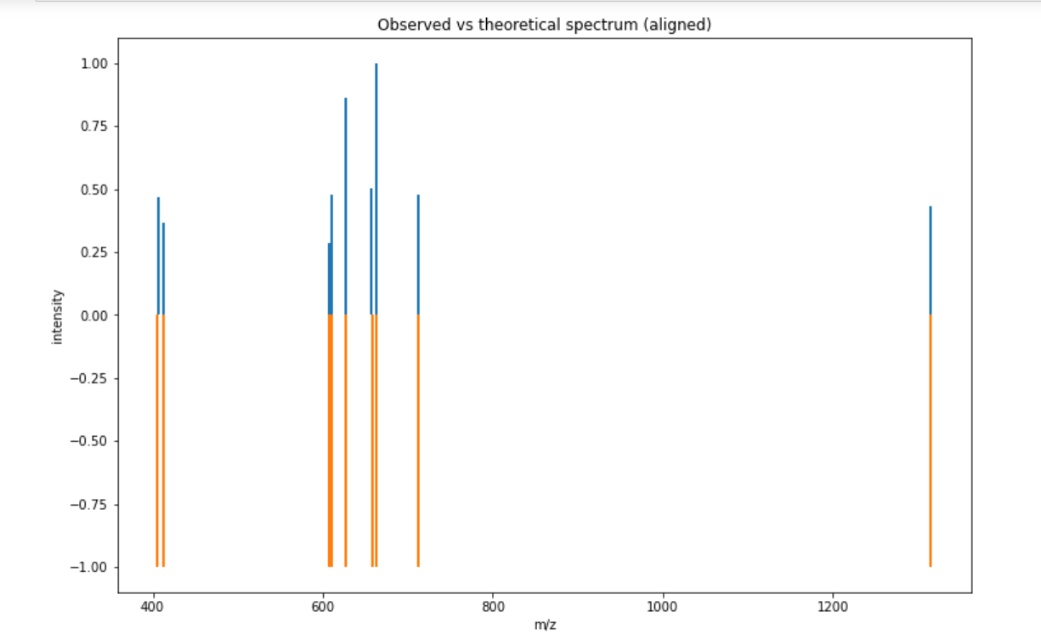
Spectra
peptide
Matched peaks
mirror plot

Slide 22
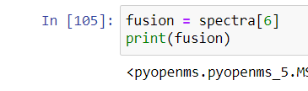
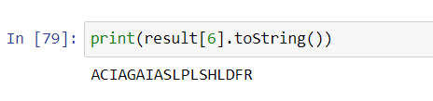
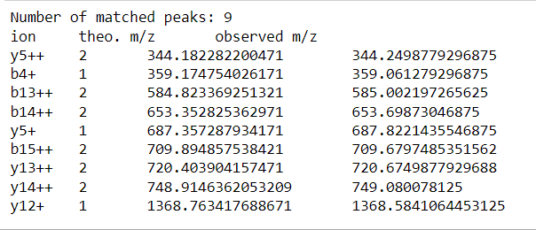
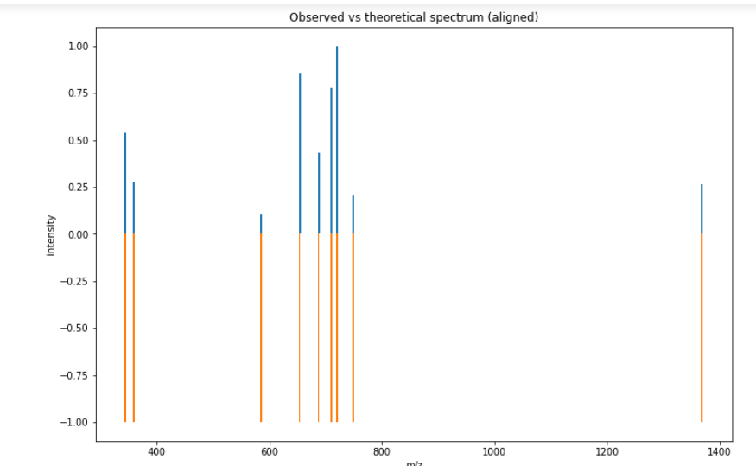
Spectra
peptide
Matched peaks
mirror plot
Fusion_180220_15.raw

Slide 23
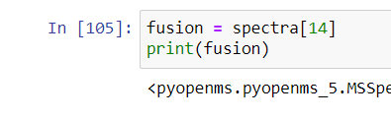
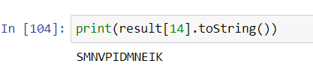
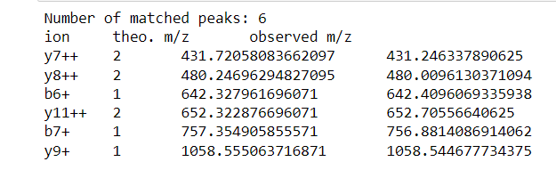
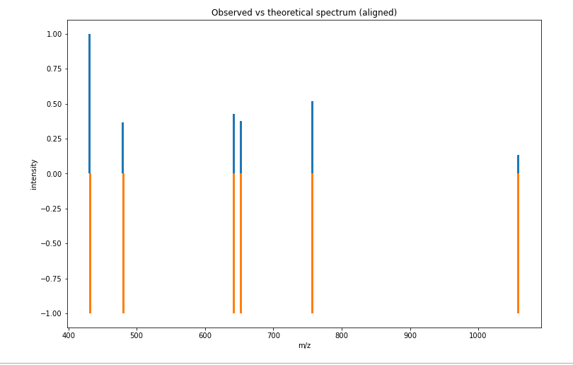
Spectra
peptide
Matched peaks
mirror plot
Fusion_180220_16.raw

Slide 24
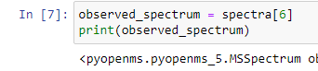
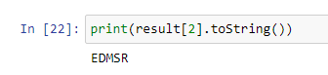
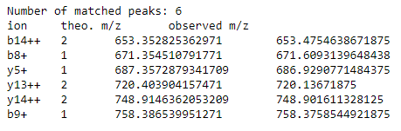
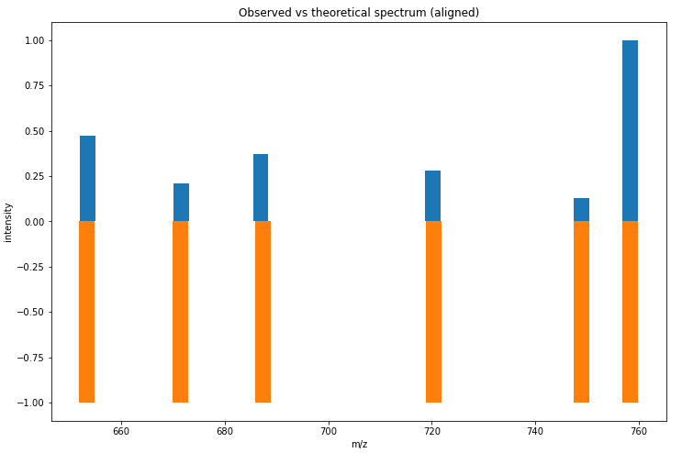
Spectra
peptide
Matched peaks
mirror plot
Fusion_180220_09.raw

Slide 25
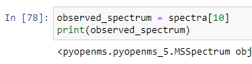



Spectra
peptide
Matched peaks
mirror plot
Fusion_180220_10.raw

Slide 26




Spectra
Matched peaks
peptide
mirror plot
Fusion_180220_11.raw

Slide 27




Spectra
Matched peaks
peptide
mirror plot
Fusion_180220_12.raw

Slide 28

THE End OF THE SHOW
Thank You For Your Time

